Slide 1
The History of Computer Vision

Slide 2
How Machines Learned to “See”
Sense the world with the right waves (radio, sound, light).
Compute just enough to turn raw signals into distance, shape, motion, and objects.
Fuse sensors so one covers another’s weaknesses (radar = all-weather; LiDAR = precise 3D; cameras = rich detail).
Notes:
How machines learned to “see”:
Sense the world with the right waves (radio, sound, light).
Compute just enough to turn raw signals into distance, shape, motion, and objects.
Fuse sensors so one covers another’s weaknesses (radar = all-weather; LiDAR = precise 3D; cameras = rich detail). That loop—sense → compute → fuse—drives every era of computer vision.

Slide 3
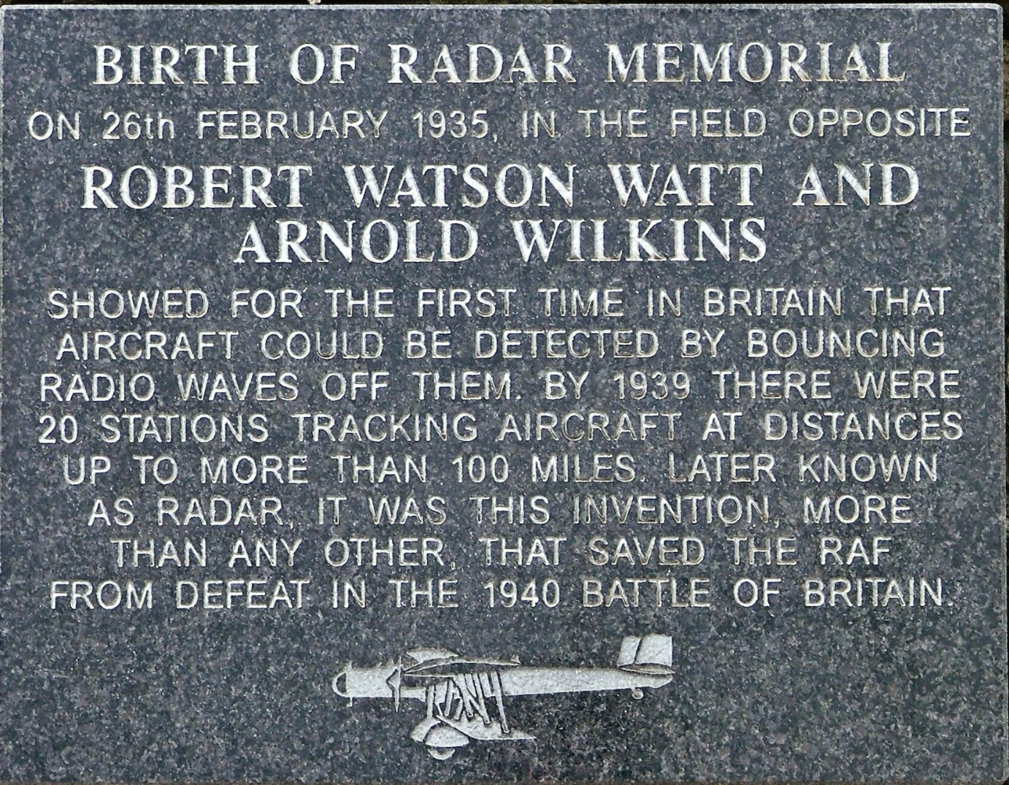
Radar: 1886 to 1940s
Originally: RAdioDetectionAndRanging
Use: Detect ships and planes through fog, clouds, and at long range.
Who/when:
German physicist Heinrich Hertz showed that radio waves could be reflected from solid objects (1886)
Christian Hülsmeyer demos ship detection (1904).
Robert Watson-Watt and colleagues field Britain’s Chain Home air-defense radar by 1938.
Notes:
Why we built it: Detect ships and planes through fog, clouds, and at long range.
Who/when: Christian Hülsmeyer demos ship detection (1904). Robert Watson-Watt and colleagues field Britain’s Chain Home air-defense radar by 1938.
How (in one line): Send a radio pulse, time the echo (time-of-flight) to get distance; measure Doppler shift for approach speed; steer beams with antenna arrays.
Limits: Coarse detail unless antennas are huge; clutter/interference.
Fun fact: Chain Home masts were so tall they doubled as landmarks for pilots trying to avoid being detected.

Slide 4
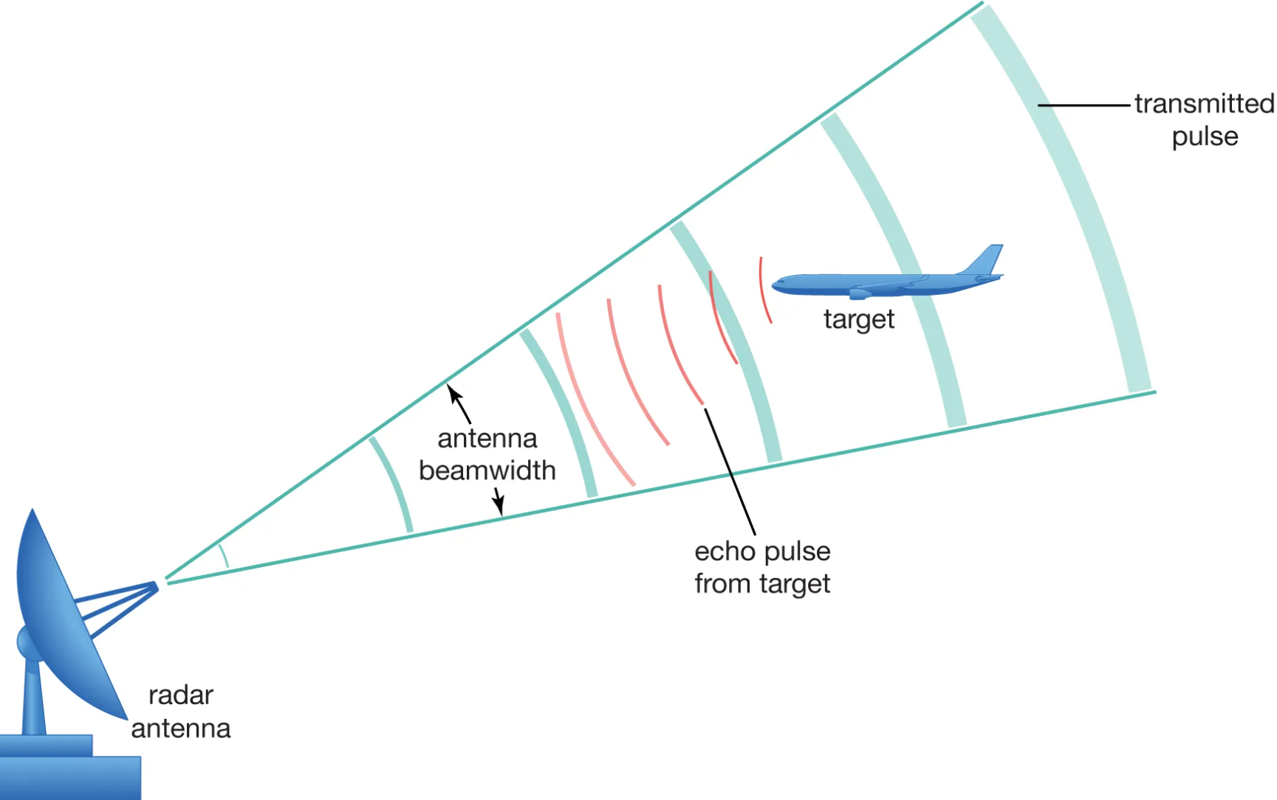
Radar: 1886 to 1940s
How: Send a radio pulse, time the echo (time-of-flight) to get distance; measure Doppler shift for approach speed; steer beams with antenna arrays.
Limits: Coarse detail unless antennas are huge; clutter/interference.
Fun fact: Chain Home masts were so tall they doubled as landmarks for pilots trying to avoid being detected.
Notes:
Why we built it: Detect ships and planes through fog, clouds, and at long range.
Who/when: Christian Hülsmeyer demos ship detection (1904). Robert Watson-Watt and colleagues field Britain’s Chain Home air-defense radar by 1938.
How (in one line): Send a radio pulse, time the echo (time-of-flight) to get distance; measure Doppler shift for approach speed; steer beams with antenna arrays.
Limits: Coarse detail unless antennas are huge; clutter/interference.
Fun fact: Chain Home masts were so tall they doubled as landmarks for pilots trying to avoid being detected.

Slide 5
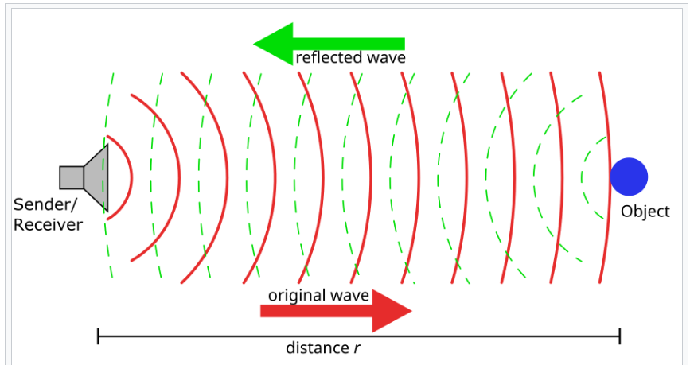
Sonar: 1912–1918 to 1930s
Originally: Sound/Sonic Navigation and Ranging
Use: Radio doesn’t travel well in seawater; navies needed submarine detection. Possibly prompted by Titanic Disaster
Who/when: Reginald Fessenden pioneers echo-ranging (1912–13); Paul Langevin builds practical active sonar during WWI with piezoelectric crystals.
Notes:
Why: Radio doesn’t travel well in seawater; navies needed submarine detection.
Who/when: Reginald Fessenden pioneers echo-ranging (1912–13); Paul Langevin builds practical active sonar during WWI with piezoelectric crystals.
How: Send an ultrasound ping; the echo’s delay gives distance. Hydrophone arrays “beamform” to map direction and the seafloor (side-scan, multibeam).
Limits: Sound is slow (echoes smear), noisy oceans, big arrays for sharp angles.
Fun fact: Early British sonar was nicknamed ASDIC; the acronym’s origin is still a bit mysterious in naval lore.

Slide 6
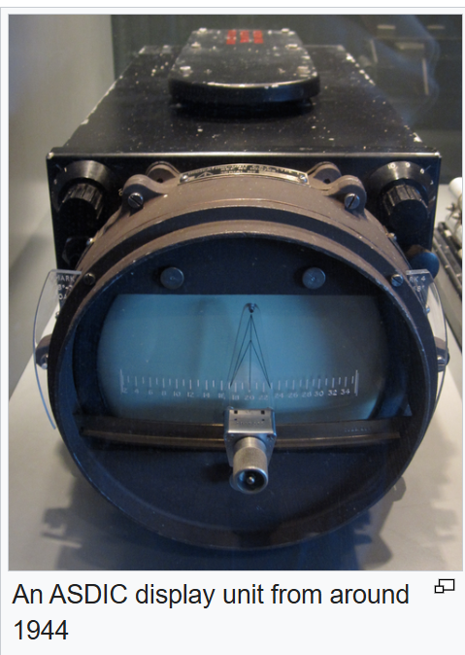
Sonar 1912–1918 to 1930s
How: Send an ultrasound ping; the echo’s delay gives distance.
Limits: Slow, oceans are noisy, big arrays for sharp angles.
Fun fact: Early British sonar was nicknamed ASDIC; the acronym’s origin is still a bit mysterious in naval lore because it was so top secret at the time.
Notes:
Why: Radio doesn’t travel well in seawater; navies needed submarine detection.
Who/when: Reginald Fessenden pioneers echo-ranging (1912–13); Paul Langevin builds practical active sonar during WWI with piezoelectric crystals.
How: Send an ultrasound ping; the echo’s delay gives distance. Hydrophone arrays “beamform” to map direction and the seafloor (side-scan, multibeam).
Limits: Sound is slow (echoes smear), noisy oceans, big arrays for sharp angles.
Fun fact: Early British sonar was nicknamed ASDIC; the acronym’s origin is still a bit mysterious in naval lore.

Slide 7
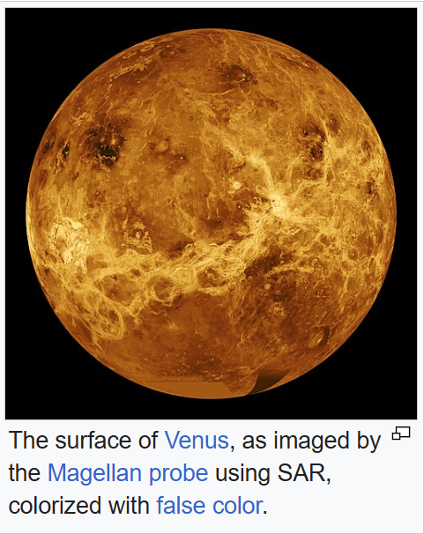
Synthetic Aperture Radar (SAR) — (1951 to present)
Use: Uses the motion of the radar antenna over a target region to provide finer spatial resolution than conventional stationary beam-scanning radars
Who/when: Carl A. Wiley (Goodyear) formalizes SAR in 1951.
Notes:
Why: Classic radar made blobby images; we wanted maps with sharp detail.
Who/when: Carl A. Wiley (Goodyear) formalizes SAR in 1951.
How: Fly radar along a path and coherently combine many echoes so motion “synthesizes” a very long antenna → high-resolution images day/night, through clouds.
Limits: Heavy computation; sensitive to motion/phase errors.
Fun fact: SAR has revealed buried rivers in deserts and tracked millimeter-scale volcano swelling via interferometry (InSAR).

Slide 8
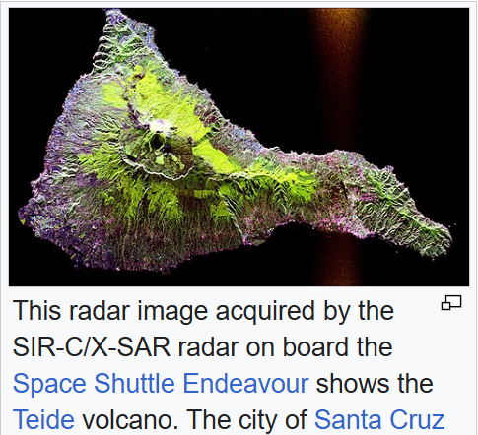
Synthetic Aperture Radar (SAR) — (1951 to present)
How: Fly radar along a path and combine many echoes so motion “synthesizes” a very long antenna →
High-resolution images day/night, through clouds.
Limits: Heavy computation; sensitive to motion/phase errors.
Fun fact: SAR has revealed buried rivers in deserts and tracked millimeter-scale volcano swelling via interferometry (InSAR).
Notes:
Why: Classic radar made blobby images; we wanted maps with sharp detail.
Who/when: Carl A. Wiley (Goodyear) formalizes SAR in 1951.
How: Fly radar along a path and coherently combine many echoes so motion “synthesizes” a very long antenna → high-resolution images day/night, through clouds.
Limits: Heavy computation; sensitive to motion/phase errors.
Fun fact: SAR has revealed buried rivers in deserts and tracked millimeter-scale volcano swelling via interferometry (InSAR).

Slide 9
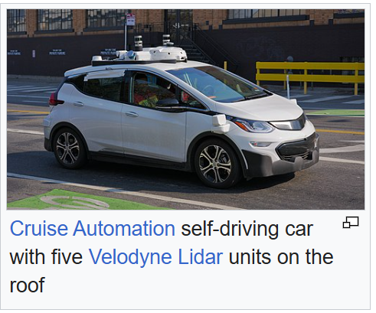
Lasers & LiDAR —(1960s to present)
Originally: Light Detection and Ranging/ Laser Imaging, Detection, and Ranging
Use: Remote sensing technology that uses pulsed laser light to measure distances and create detailed 3D maps
Who/when: Theodore Maiman fires the first laser (1960). Within a year, Hughes prototypes laser radar (LiDAR). Apollo 15 (1971) flies the first spaceborne laser altimeter.
Notes:
Why: Pictures are 2D; mapping, robotics, and autonomy need precise distances.
Who/when: Theodore Maiman fires the first laser (1960). Within a year, Hughes prototypes laser radar (LiDAR). Apollo 15 (1971) flies the first spaceborne laser altimeter.
How: Fire a short laser pulse and time its round-trip to each surface point; scanning mirrors sweep the scene, building a 3D point cloud. (Newer FMCW LiDAR mixes frequencies to get distance and velocity.)
Limits: Attenuates in heavy fog/rain; historically bulky/expensive (now trending smaller/cheaper).
Fun fact: Airborne LiDAR has uncovered hidden Mayan cities beneath jungle canopy.

Slide 10
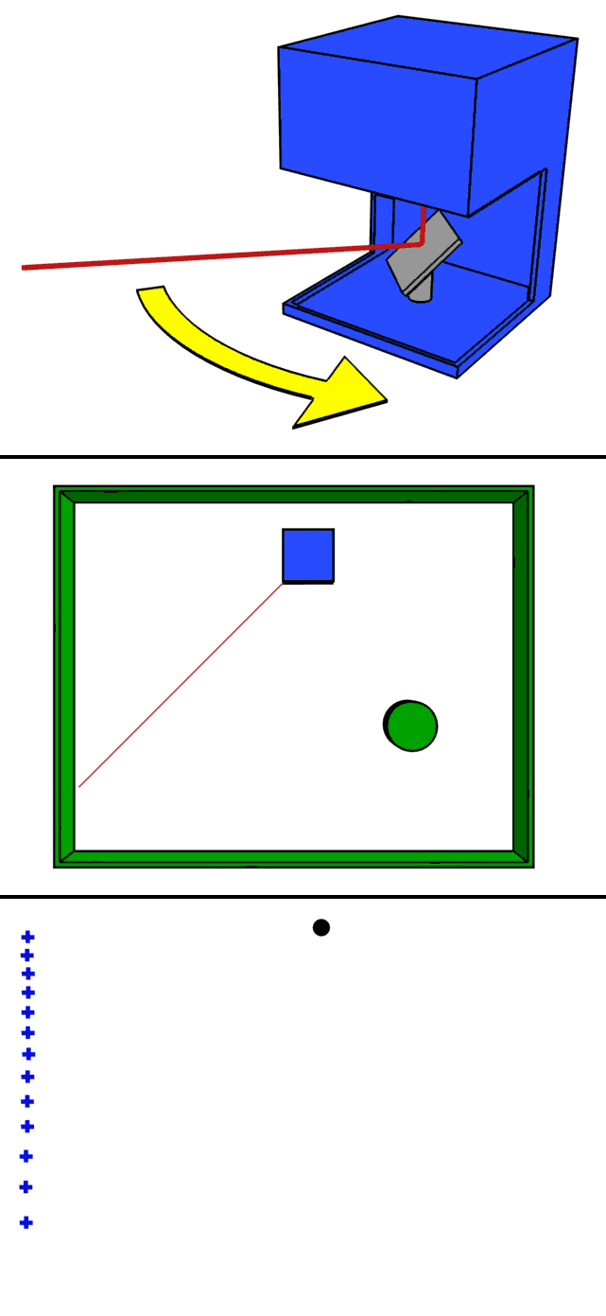
Lasers & LiDAR —(1960s to present)
How: Fires a short laser pulse and time its round-trip to each surface point; scanning mirrors sweep the scene, building a 3D point cloud.
Limits: Attenuates in heavy fog/rain; historically bulky/expensive (now trending smaller/cheaper).
Fun fact: Airborne LiDAR has uncovered hidden Mayan cities beneath jungle canopy.
Notes:
Why: Pictures are 2D; mapping, robotics, and autonomy need precise distances.
Who/when: Theodore Maiman fires the first laser (1960). Within a year, Hughes prototypes laser radar (LiDAR). Apollo 15 (1971) flies the first spaceborne laser altimeter.
How: Fire a short laser pulse and time its round-trip to each surface point; scanning mirrors sweep the scene, building a 3D point cloud. (Newer FMCW LiDAR mixes frequencies to get distance and velocity.)
Limits: Attenuates in heavy fog/rain; historically bulky/expensive (now trending smaller/cheaper).
Fun fact: Airborne LiDAR has uncovered hidden Mayan cities beneath jungle canopy.

Slide 11
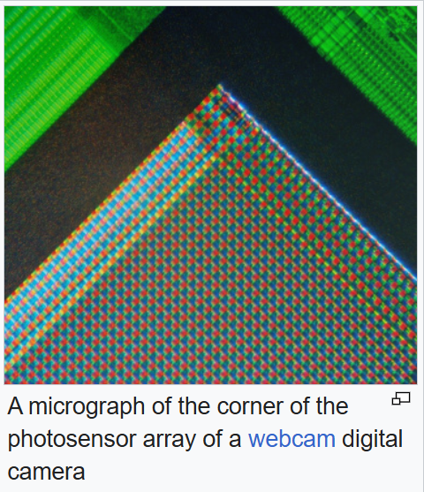
Electronic Imaging (1969 to present)
Use: To turn light into digital images we can compute on.
Who/when: Willard Boyle & George E. Smith invent the sensors that allow images to be captured
How: Photons → electrons in pixel wells → read out as pixels
Limits: Needs light (or IR/NIR); rolling-shutter artifacts on fast motion.
Fun fact: Your phone camera is a tiny image sensor—an entire TV studio on a fingernail.
Notes:
Electronic imaging — CCD/CMOS cameras (1969 →)
Why: To turn light into digital images we can compute on.
Who/when: Willard Boyle & George E. Smith invent the CCD (1969); later CMOS brings low-power, on-chip processing.
How: Photons → electrons in pixel wells → read out as pixels; color via Bayer mosaics + demosaicing.
Limits: Needs light (or IR/NIR); rolling-shutter artifacts on fast motion.
Fun fact: Your phone camera is a tiny CMOS image sensor—an entire TV studio on a fingernail.

Slide 12
Early Computer Vision (1970s – 1980s)
Put pixel values into a 0 – 1 range so math is stable and comparable.
Sufficient for edge/corner/blob detection,
8-bit images divide by 255.0
16-bit images: divide by 65535.0
Ex 8-bit image
RGB(243, 100, 2) = RGB(0.953, 0.392, 0.008)
Notes:
Early computer vision — “from pixels to meaning” (1970s–1980s)
Why: Once we could capture images, we needed to interpret them.
Who/what: David Marr & Ellen Hildreth (edge theory), John Canny (optimal edge detector), Berthold Horn & Brian Schunck and Lucas–Kanade (optical flow), Lawrence Roberts (3D from line drawings).
How: Smooth → find edges; track corners; estimate motion between frames; use stereo pairs to triangulate depth; optimize camera poses/points (bundle adjustment).
Limits: Math was elegant but brittle on cluttered, real-world scenes.
Fun fact: Early edge detectors still show up inside modern deep nets—just learned rather than hand-coded.

Slide 13
Intensity Scaling
Standardize based on training data values
Necessary for machine learning modeling
Compute one mean and one std per color channel across all pixels of all images in the training set.
Compares the R, G and B values for that image to the other images in the dataset
R: µ = 0.90, σ = 0.16
G: µ = 0.45, σ = 0.10
B: µ = 0.055, σ = 0.07
RGB(0.953, 0.392, 0.008) = RGB(0.33, -0.58, 0.85)
R: (0.953 - 0.90)/ 0.16 = 0.33
G: (0.392 - 0.45)/ 0.10 = -0.58
B: (0.055 - 0.008)/ 0.055 = 0.85
Notes:
Hand-crafted features & real-time tricks (1990s–2000s)
Why: Make recognition robust across scale, rotation, lighting and run fast.
Who/what: SIFT (David Lowe) keypoints & descriptors; HOG (Dalal–Triggs) for people; Viola–Jones face detector (Haar features + boosted cascades); RANSAC for outlier-proof model fitting.
How: Detect stable keypoints, describe local gradients, and match; or slide a window with fast features.
Limits: Plateaued on large, messy datasets; struggled with big viewpoint changes.
Fun fact: Viola–Jones made point-and-shoot cameras auto-focus on faces—one of the first CV features billions of people used daily.

Slide 14
Save and Document
Save the processed images or save a script/config that can regenerate them on demand.
Record the exact steps and parameters
Fix random seeds. Keep version numbers of libraries.
Notes:
Affordable depth for everyone — Kinect & structured light (2010)
Why: Low-cost 3D for gaming, robotics, and research.
Who/when: Microsoft Kinect (PrimeSense tech) launches in 2010.
How: Project a known IR dot pattern and see how it warps on surfaces to compute depth (structured light).
Fun fact: Kinect became (for a while) the fastest-selling consumer electronics device ever and jump-started a wave of home-brew robotics.

Slide 15
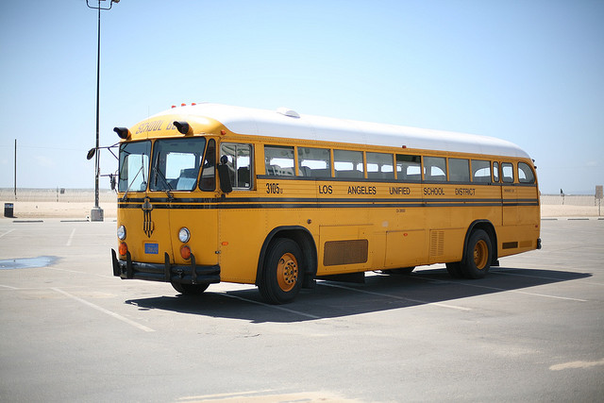
COCO Dataset
COCO (Common Objects in Context) is a large-scale dataset for object detection hosted at cocodataset.org. COCO Dataset
Designed to capture everyday scenes “in context,” not just centered objects.
Introduced in 2014 by Lin et al. (“Microsoft COCO: Common Objects in Context”)
Notes:
Deep learning takes over (2012–late 2010s)
Why now: Big labeled datasets (ImageNet) + GPUs for training.
Breakthroughs: AlexNet (2012) crushes ImageNet; ResNet (2015) uses skip connections to train very deep nets. Detection/segmentation leap with R-CNN → Faster R-CNN → Mask R-CNN, and real-time YOLO/SSD.
How (intuition): Stacks of learned filters go edges → parts → objects; the system learns features from data instead of us hand-engineering them.
Limits: Data-hungry; can be brittle out of distribution; compute-intensive.
Fun fact: AlexNet trained on two gaming GPUs—a student-built system that changed an entire field.

Slide 16

Python Pillow Library
PIL (Python Imaging Library) was created by Fredrik Lundh and Secret Labs AB, first released 1995. Development of PIL effectively stopped around 2011.
Pillow is the actively maintained, “friendly PIL fork,” started in 2010 by Jeffrey “Alex” Clark with community contributors; it added Python 3 support and ongoing releases.
Notes:
Deep learning takes over (2012–late 2010s)
Why now: Big labeled datasets (ImageNet) + GPUs for training.
Breakthroughs: AlexNet (2012) crushes ImageNet; ResNet (2015) uses skip connections to train very deep nets. Detection/segmentation leap with R-CNN → Faster R-CNN → Mask R-CNN, and real-time YOLO/SSD.
How (intuition): Stacks of learned filters go edges → parts → objects; the system learns features from data instead of us hand-engineering them.
Limits: Data-hungry; can be brittle out of distribution; compute-intensive.
Fun fact: AlexNet trained on two gaming GPUs—a student-built system that changed an entire field.

Slide 17
Python Pillow Library
Open/save many formats (JPEG, PNG, TIFF, WebP, etc.).
EXIF support (read metadata, auto-rotate via Orientation).
Resizing, cropping, rotate/transpose; affine & perspective transforms.
Color modes & conversion (RGB/RGBA/CMYK/L/P) + ICC/Color management
Filters & enhancements (blur/sharpen; brightness/contrast/color/sharpness).
Draw text/shapes (ImageDraw, ImageFont).

Slide 18
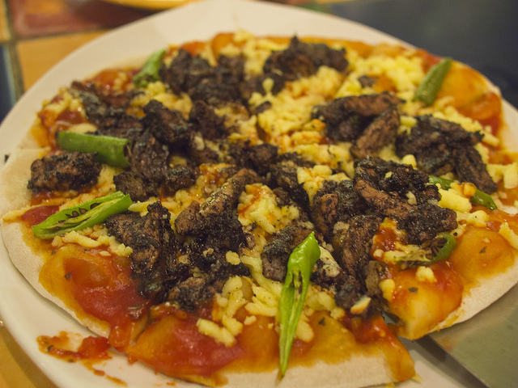
Let’s Do It!

Slide 19
The 2020s — transformers, multimodality, and generative vision
Vision Transformers (ViT): Treat images as patch tokens; use self-attention (no convolutions) to relate everything to everything.
DETR: Recasts detection as set prediction with attention—no proposal heuristics.
CLIP & friends: Train on (image, text) pairs so a simple prompt (“a photo of a red fox”) can recognize images zero-shot.
Segment Anything (SAM): Promptable segmentation—click or box anywhere and get an object mask instantly.
Diffusion & NeRFs: Generative models synthesize/modify images; NeRFs reconstruct scenes from photos to render new views.
Edge & fusion: Commodity devices now fuse camera + radar + LiDAR in cars/robots; phones run surprisingly capable on-device CV.
Fun fact: CLIP-style training scraped so many image-captions that models picked up memes—and sometimes, meme biases—sparking new work on fairness.

